Slide 1
FUNDAMENTALS OF COMPUTERS

Slide 2
UNIT-I Introduction to computers
Computers
Stored Program Concept
Classification of Computers
Evolution and Development of Computers
Application Area of Computers
Features/Characteristics of Computers
Basic Organization of a Computer

Slide 3
Computer:
A Computer is an electronic device that is designed to accept data, perform the required mathematical and logical operations at high speed, and output the result.
A Computer is an electronic device that takes data and Instructions as an input from the user, process the data and provides useful information known as output.
Data
Process
Information
Storage

Slide 4
Computer Architecture:

Slide 5
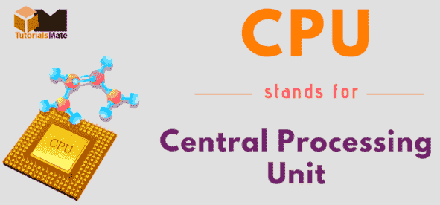
Central processing unit(CPU):
A central processing unit, also called a central processor, main processor or just processor, is the electronic circuitry that executes instructions comprising a computer program.
The CPU performs basic arithmetic, logic, controlling, and input/output operations specified by the instructions in the program.

Slide 6
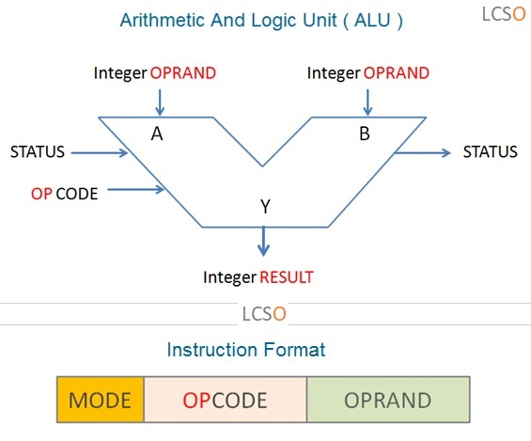
ALU (Arithmetic Logic Unit):
ALU is a main component of the central processing unit, which stands for arithmetic logic unit. Its performs arithmetic and logic operations.
Control Unit:
It acts as the brain of the CPU because it controls and manage the execution of Instructions.

Slide 7
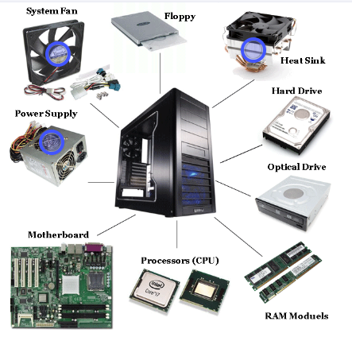
Computer Peripheral Devices :

Slide 8
History:
Charles Babbage was an English Mathematician.
He is known as the Father of Computers.
He was invented the first analytical computer in the year 1822.
Ada Byron developed a set of of instructions used to operate the machine.
Analytical engine was extended by Atana Soff and Clifford Bery using electronic components.
This machine was known as ABC (Atana Soff Bery Computer) but it required a human operator to give the instructions but it was unable to internally store the replaceable set of instructions.

Slide 9
Next extension is done by Dr.Mauchly who has developed a machine called ENIAC which stands for “Electrical Numerical Integrated And Computer”.
ENIAC machine could perform the calculations but the storage requirement was not satisfied.
The final goal of stored program computer which can internally store the data as well as the instructions is acheived by Cambridge University in 1949 which is known as EDSAC (Electronic Delayed Storage Automatic Computer).
In addition to performing calculations the EDSAC could store both the data and instructions that directed the computer operations.

Slide 10
The EDSAC contained a form of memory, whose principles are developed by Von Neumann that allowed it to retrive an instruction and data needed to carry out an operation.
The same principle is used in today’s computers also but the difference is found in size and speed of the components.

Slide 11
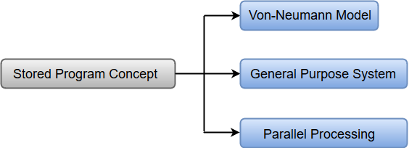
Stored Program Concept :
All digital computers are based on the principle of stored program concept , which was introduced by Sir Johan von Neumann in the late 1940s.
A computer with a Von Neumann architecture stores data and instructions in the same Memory.
This is a serial machine in which data and instructions are selected one at a time.
Data and instructions are transferred to and from memory through a shared data bus.

Slide 12
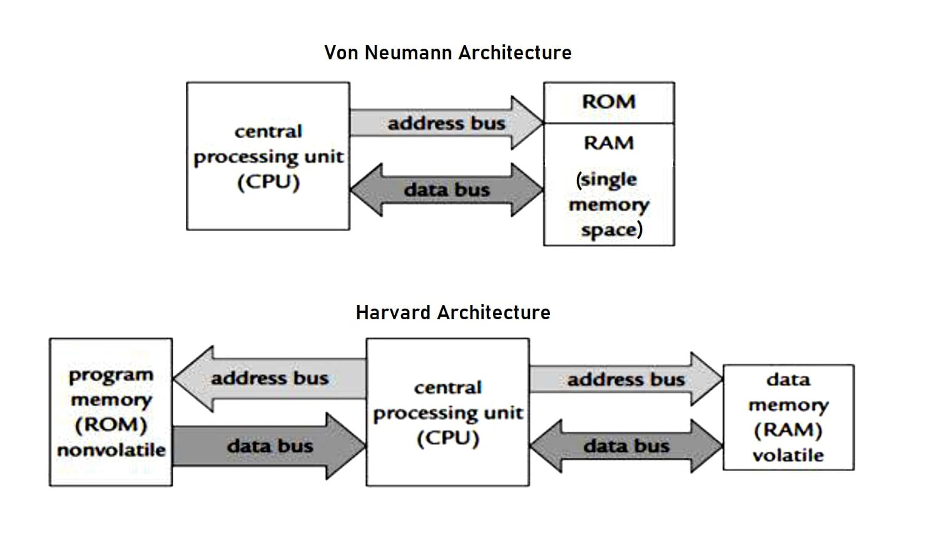
Stored Program Concept :

Slide 13
Stored Program Concept :
Key features of Stored program concept
Before data processed, Instructions are read into the memory
Instructions are stored in the computers memory for execution
Instructions are stored in binary form
Proccessing starts with the first instruction in the program
Input/Output and processing operations are performed simultaneously

Slide 14
Classification of computers:
Based on physical size computers can be classified into four main groups
Super computers
Mainframe computers
Minicomputers
Microcomputers

Slide 15
SUPERCOMPUTERS:
Supercomputers are the fastest, largest, most expensive & also the most powerful computers available.
Characteristics:
Fastest computers
Largest in size
Most expensive
Huge processing power
Very heavy
Generate a lot of heat
Use multiple processors
They are operated by computer specialists. A Supercomputer can be operated by over 500 users at the same time

Slide 16
Applications:
Scientific research
Defense and weapon analysis
Nuclear energy research
Weather forecasting
Petroleum research
Examples of Supercomputers:
CRAY T3D
NEC-500.
CDC 6600
ABC (Atanasoff-Berry Computer)
ENIAC

Slide 17
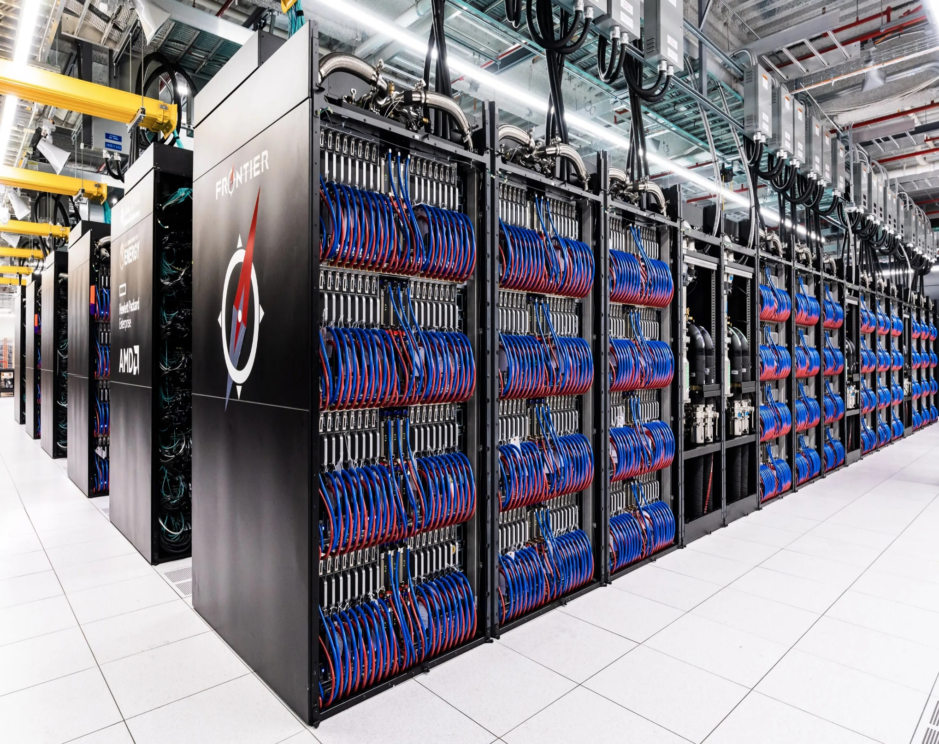

Slide 18
Mainframe computers:
Mainframes are less powerful & less expensive than supercomputers. Mainframe executes many programs concurrently and supports many simultaneous execution of programs. They are mostly found in government and big organizations such as banks, hospitals, airports etc…
Characteristics:
Have a large storage capacity
Large in size
Multi-user
Multi-processing
Supports a variety of peripherals
Areas where mainframe computers are used:
Mainframe computers are mostly found in government departments, big organizations and companies which have large information processing needs, e.g., they are used;
In Banks & Hospitals for preparing bills, Payrolls, etc.
In communication networks such as the Internet where they act as Servers.
By Airline reservation systems where information of all the flights is stored.

Slide 19
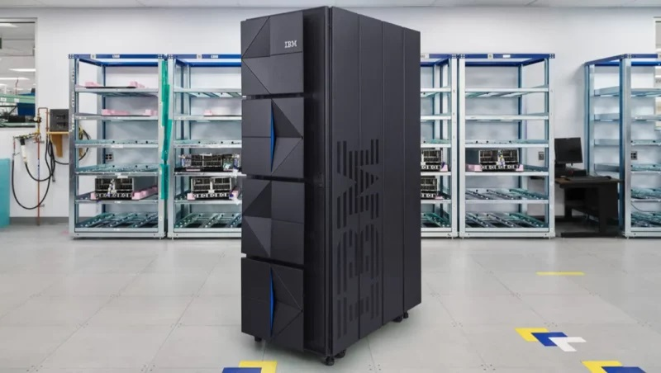
Examples of Mainframes:
IBM 360,4381.
ICL 39 Series.
CDC Cyber series.
BINAC
UNIVAC

Slide 20
Minicomputers:
A Minicomputer is physically smaller than a mainframe. However, it can support the same peripheral devices supported by a mainframe.
Characteristics:
Multi-user, e.g., can be operated by 6 users at a time.
Cheaper than the mainframes
They handle small amounts of data, are less powerful, & have less memory than the mainframes.
Minicomputers are slow compared to mainframe computers.
Applications:
Used in scientific laboratories
Used in research institutions
Engineering plants
Automatic processing

Slide 21
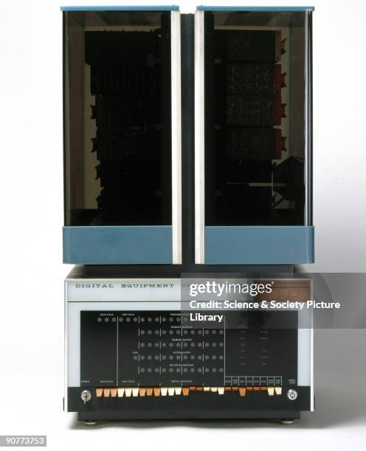

Slide 22
Microcomputers:
Microcomputers are the PCs mostly found today in homes, schools & many small offices. They are called Personal Computers (PCs) because they are designed to be used by one person at a time.
Characteristics:
Are cheaper than both mini & mainframe computers.
Are very fast (i.e. have high processing speeds).
Small in size, hence they occupy less space in an office.
Are more energy efficient (i.e., consume less power).
Are more reliable than the early Mainframe computers.
Areas where microcomputers are used:
Training and learning institutions such as schools.
Small business enterprises
Communication centers as terminals.

Slide 23
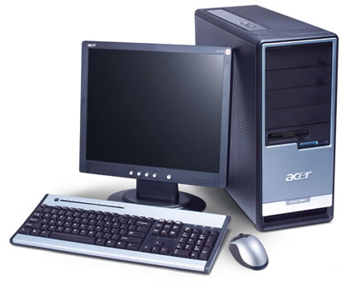
The following are the various types of microcomputers in operation today arranged in descending order according to size.
Desktop computer: is designed to be placed on top of an office desk
Notebook or laptop: portable convenient for mobile users.
Personal Digital Assistant(PDA): Is small enough to fit in the pocket

Slide 24
Evolution and Development of Computers
A Computer generation is a grouped summary of the gradual developments in the computer technology.
It took several years after Babbage designed the analytical engine to come up with an electronic computer. The age of modern computers can be traced back to 1951.
These computers are classified into five generations depending on the technology used to develop them.
First generation computers
Second generation computers
Third generation computers
Fourth generation computers
Fifth generation computers

Slide 25
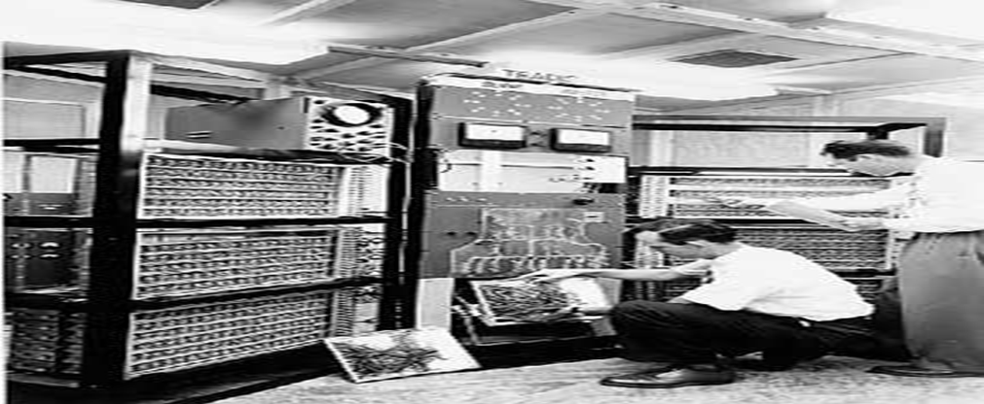
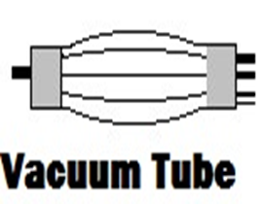
First generation computers(1940-1958):
The 1st generation of computers used thousands of electronic gadgets called Vacuum tubes or Thermionic valves to store & process information.
The main features of first generation are:
Vacuum tube technology
Their internal memory capacity was limited. The maximum memory size was approx. 2 KB (2,000 bytes).
Supported machine language only
Very costly
Generated lot of heat
Huge size- For example, ENIAC occupied an area of about 150m2
Non-portable

Slide 26
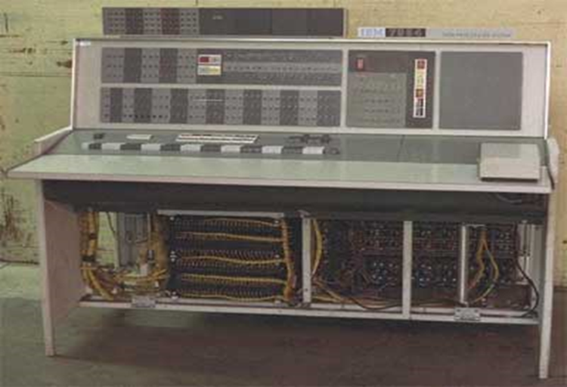
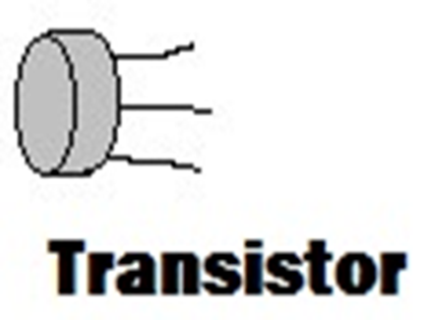
Some computers of this generation were:
ENIAC (Electronic Numerical Integrator And Calculator) built in 1946 for use in World War
EDVAC (Electronic Discrete Variable Automatic Computer)
UNIVAC (Universal Automatic Computer).
IBM 650.
LEO (Lyon’s Electronic Office)..
Second generation computers (1942-1955):
The 2nd generation computers used tiny, solid-state electronic devices called Transistors. The transistors were relatively smaller, more stable & reliable than vacuum tubes.

Slide 27
Second generation computers (1955-1964):
The computers were smaller in size & therefore, occupied less space compared to the 1st G computers.
Use of transistors
Reliable in comparison to first generation computers
Smaller size as compared to first generation computers
Generated less heat as compared to first generation computers
They were less costly than the 1st G computers.
They used Magnetic core memories.
RAM Memory size expanded to 32 KB.
Consumed less electricity as compared to first generation computers
Faster than first generation computers
Examples of 2nd Generation computers:
NCR 501, IBM 300, IBM 1401, IBM 7070, IBM 7094 Series & CDC-6600 Mainframe computers.
ATLAS LEO Mark III.
UNIVAC 1107.
HONEYWELL 200.

Slide 28
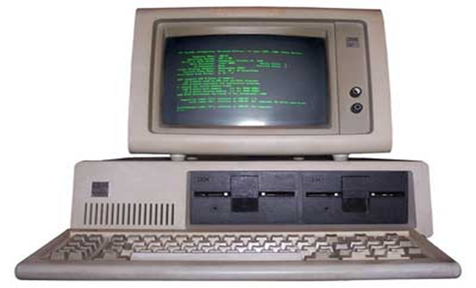
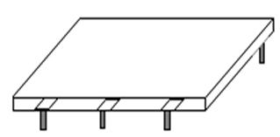
Third Generation Computers (1964 – 1975):
Used electronic devices called Integrated Circuits (ICs), which were made by combining thousands of transistors & diodes together on a semiconductor called a Silicon chip.
The main features of third generation are:
More reliable in comparison to previous two generations
They were smaller in size compared to 2nd generation computers.
Generated less heat
Lesser maintenance
The computers used a wide range of peripheral devices.
Magnetic disks were developed for storage purposes.
Examples of 3rd Generation computers:
IBM 360, 370;
ICL 1900 Series;
PDP (Personal Data Processor)
Honeywell-6000 series
TDC-316

Slide 29
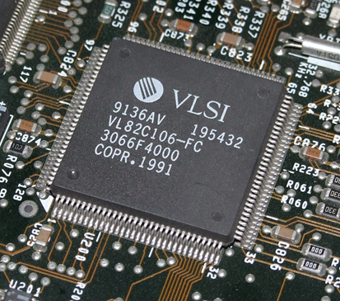
Fourth Generation Computers (1975 – 1989):
Computers are manufactured using ICs with VLSI ,
The main features of fourth generation are:
Faster
They were smaller in size
Reliable
The computers used for scientific, network applications
Examples of fourth Generation computers:
IBM PC
Apple II
TRS-80
VAX-900

Slide 30
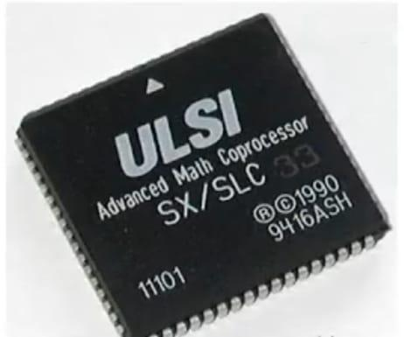
Fifth Generation Computers (1989 – Till):
Computers are manufactured using ICs with ULSI
The main features of fifth generation are:
Powerful
They were smaller in size
The computers used for scientific, commercial
Consume less power
Examples of Fifth Generation computers:
IBM Notebooks
Pentium PCs
Param super computer
IBM SP/2

Slide 31
Application Areas of Computers:
1) Education:
Computers are widely used in the teaching & learning process. Learning and teaching using computers is referred to as Computer Aided Learning (CAL) and Computer Aided Teaching (CAT).
To analyze academic data.
2) Communication industry:
The integration of computers & telecommunication facilities has made the transmission and reception of messages very fast and efficient.
They are used in telephone exchanges to switch incoming & outgoing calls.
For sending & receiving electronic messages, e.g. fax and e-mails, if connected to a computer network.
3) Transport industry:
Automobile traffic control, e.g., to monitor vehicle traffic in a busy town.
Railway corporations to co-ordinate the movement of their goods & wagons.
Airports (Airline industry):
To control the movement of aircrafts, take off & landing through the use of radar equipment.
Making reservations (booking purposes).
Storing flight information.

Slide 32
4) Library services:
­To enable the library personnel to easily access & keep updated records of books and other library materials.
­To search for book titles instead of using the manual card catalogue.
5) Domestic and Entertainment systems:
Computers are used at homes
For watching movies, playing music and computer games.
For storing personal information.
For calculating and keeping home budgets.
6) Multimedia applications:
Computers are used to prepare business presentations for advertisement purposes.
The presentations are done using overhead projectors attached to computers running slide shows & digital video clips taken using a Camcorder.
In entertainment (i.e., games & movies), computers are used to add stereo sound & digital video clips, which make games more realistic

Slide 33
7) Defense:
Computers are largely used in defense. Modern tanks, missiles, weapons etc. Military also employs computerized control systems.
Some military areas where a computer has been used are
Missile Control
Military Communication
Military Operation and Planning
Smart Weapons
8) Police (Law enforcement agencies):
The Police use computers to keep databases on fingerprints and also analyze them.
The Police also use computers for face recognition, scene monitoring & analysis, which help them to arrest traffic offenders and criminals.
The information held in computers such as fingerprints, photographs and other identification details helps law enforcers to carry out criminal investigations speedily.

Slide 34
9) Government Institutions:
Computers play an important role in government. Some major fields in this category are:
Budgets
Sales tax department
Income tax department
Male/Female ratio
Computerization of voters lists
Computerization of driving licensing system
Weather forecasting
10) Health Care:
Computers have become important part in hospitals, labs, and dispensaries. The computers are being used in hospitals to
keep the record of patients and medicines.
scanning and diagnosing different diseases.
To control life-supporting machines in the Intensive Care Units (ICU).
Diagnostic System - Computers are used to collect data and identify cause of illness.
Lab-diagnostic System - All tests can be done and reports are prepared by computer.
Surgery

Slide 35
11) Banks/Insurance industries:
To manage financial transactions. They use special cash dispensing machines called Automated Teller Machines (ATMs) to enable them provide cash deposit & withdrawal services.
For processing of Cheques.
For preparation of Payrolls.
For better record keeping and processing of documents.
To provide electronic money transfer facilities
12) Supermarkets:
Supermarkets and other retail stores use computers for stock control, i.e., to help them manage their daily activities.
­For calculating customer’s change.
­For production of receipts.
­It can be used as a barcode reader.

Slide 36
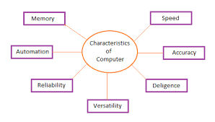
Characteristics / Features of a Computer:
:

Slide 37
Speed
A computer works with much higher speed and accuracy compared to humans while performing mathematical calculations. Computers can process millions (1,000,000) of instructions per second. The time taken by computers for their operations is microseconds and nanoseconds.
Accuracy
Computers perform calculations with 100% accuracy. Errors may occur due to data inconsistency or inaccuracy.
Diligence
A computer can perform millions of tasks or calculations with the same consistency and accuracy. It doesn’t feel any fatigue or lack of concentration. Its memory also makes it superior to that of human beings.
Versatility
Versatility refers to the capability of a computer to perform different kinds of works with same accuracy and efficiency.

Slide 38
Reliability
A computer is reliable as it gives consistent result for similar set of data i.e., if we give same set of input any number of times, we will get the same result.
Automation
Computer performs all the tasks automatically i.e. it performs tasks without manual intervention.
Memory
A computer has built-in memory called primary memory where it stores data. Secondary storage are removable devices such as CDs, pen drives, etc., which are also used to store data.

Slide 39
ADVANTAGES OF COMPUTERS:
Computers process data faster : The processing speed of a computer when measured against other devices like typewriters & calculators is far much higher.
Computers are more accurate & reliable : Computers produce more accurate results as long as the correct instructions & data are entered.
Computers are more efficient : A computer requires less effort to process data as compared to human beings or other machines.
Computers can quickly and effectively store & retrieve large amounts of data.
Computers occupy very little office space.
Computers help to reduce paper work significantly.
Computers enhance security & confidentiality : Data stored in a computer can be protected from unauthorized individuals.
Have made communication easier.
Computers produce better information:
Computers reduce the problems of data or information duplication:

Slide 40
DIS ADVANTAGES OF USING COMPUTERS:
Computers are very costly in terms of purchase & maintenance.
Computers can only be used areas where there is source of power.
Information stored in computers can easily get lost due to power interruptions or machine breakdown.
Computers have led to increase in computer crimes especially in Banks. The computer criminals steal large amounts of funds belonging to various companies by transferring them out of their company accounts illegally. In addition, they destroy vital data used in running the companies.
Use of computers can lead to some health problems, especially if not properly used. Some of the health risks include eye problems, backaches and wrist injuries.

Slide 41
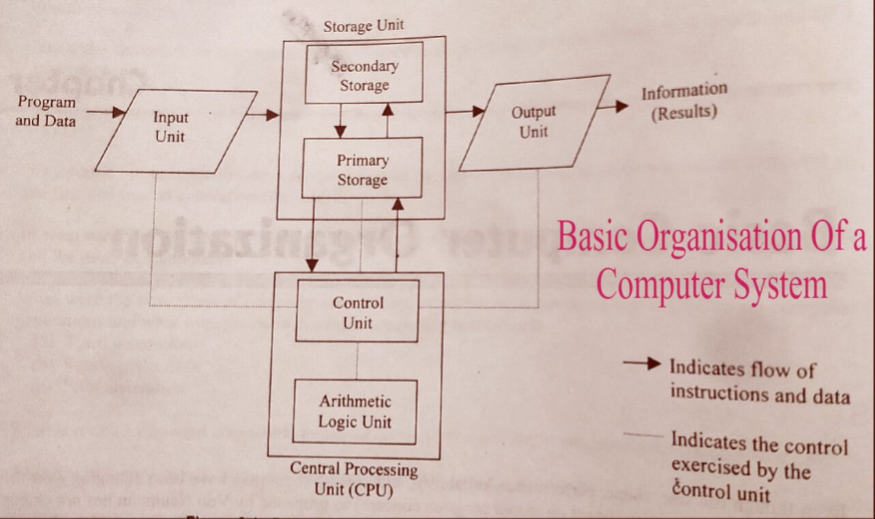
Basic Organization of a Computer

Slide 42
Input and Output Devices
Input Devices:
Keyboard
Mouse
Joy Stick
Light Pen
Microphone
Scanner
Barcode Reader
Output Devices:
Monitor
Printer
Speakers
Projector
Headphones

Slide 43
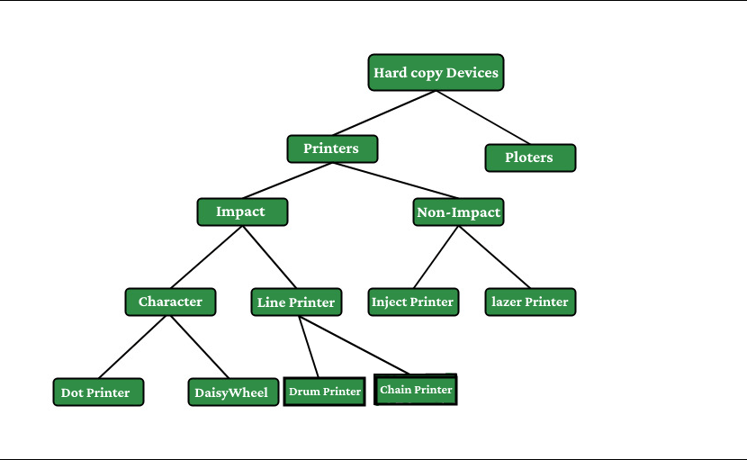
Hard Copy Devices:

Slide 44
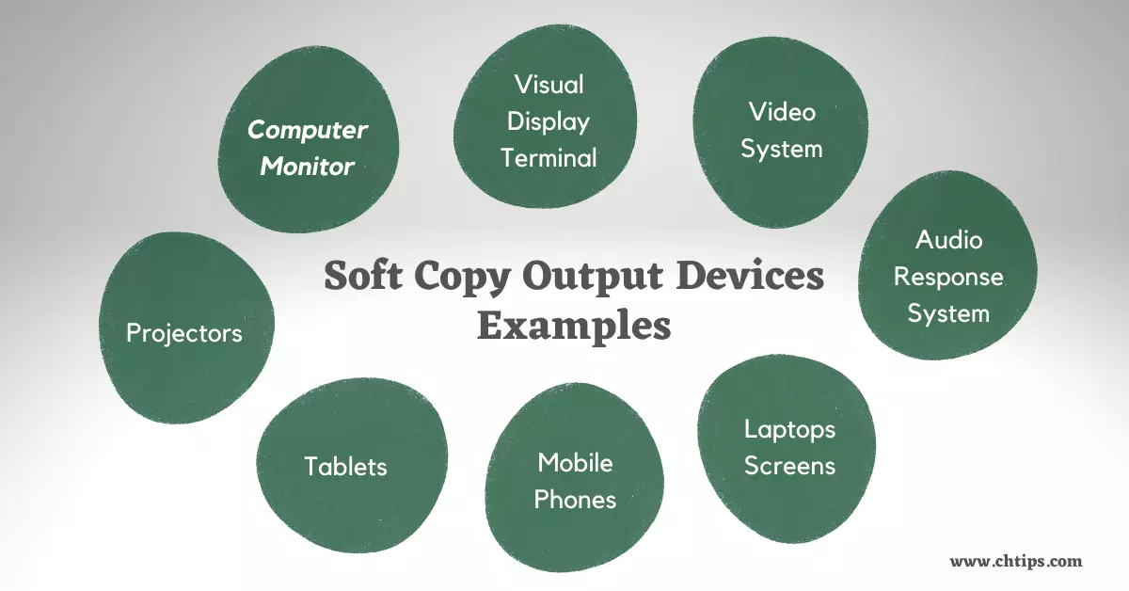
Soft Copy Devices:

Slide 45
Soft Copy and Hard Copy :
Serial No. | Hard Copy | Soft Copy
1. | Hard copy is a printed document file. | Soft copy is a non printed document file.
2. | It is a physical copy. | It is a virtual copy.
3. | It is treated as permanent copy. | It is treated as temporary copy.
4. | Hard copy does not require an electronic interface like computers or mobiles etc to read and display. | Soft copy requires an electronic interface like computers or mobiles etc to read and display.
5. | Hard copies are not easily portable like soft copy. | Soft copies are easily portable than hard copy.

